Slide 1
O&T Dashboard Weekly Project Management Status
Report Date: May 6, 2019

Slide 2
O&T Dashboard: Weekly Project Management Status
Key Ready to Serve (RTS) Activities
Accomplishments – ETL
Enhancements (20190503) Completed enhancements to Conference Room & Video Conference scripts to handle data rejections - ENHC0038188 - 5/3/19 1 Ticket closed Incidents Handled multiple STORM Attendance data load failures due to Informatica connectivity issue - INC2351812, INC2352140, INC2356463, INC2356809 – from 4/27/19 through 5/3/19 Handled Space Planning data load failure due to missing source file - INC2350510 - 4/29/19 Handled STORM Pacing dimension load failure due to network connectivity issue - INC2355790 - 5/2/19 6 Tickets closed Operational Tasks Completed production support activities for April 2019 - RITM1685980 - 4/30/19 Analyzed data rejections for Black Car Services Mosaic file - RITM1720477 - 5/1/19 Coordinated to fix NDI contractor mapping issue with EDM team - RITM1615492 - 5/2/19 Analyzed rejected record for T&E Posted Expense - RITM1728115 - 5/2/19 Manually processed missing Space planning files - RITM1713356 - 5/3/19 5 Tickets closed

Slide 3
O&T Dashboard: Weekly Project Management Status
Key Ready to Serve (RTS) Activities - In Progress Items - ETL
Ticket Headline | Module | Priority | Ticket Number | Type | Assigned To | Current Phase | Current Owner | Next Step | Request Date | Prod Date | Duration (Business Days) | Estimated Hours | Production Delayed Reason | Status | % Complete
Black Car failed due to incorrect alpine source file | Expense Reporting | P3 | INC2356672 | INC | Paul Naveen | In progress | Aswin | Complete | 5/3 | 5/7 | 3 |  |  |  | 5%
Process STORM Fiscal Date mapping file in Stage | RCO | P3 | RITM1703319 | SR | Paul Naveen | In progress | Aswin | Complete | 4/12 | 5/8 | 19 |  |  |  | 30%
Analysis on duplicate bookings in Conference Rooms dashboard | RCO | P3 | RITM1673228 | SR | Paul Naveen | In progress | Aswin | Complete | 3/21 | 5/9 | 36 |  |  |  | 75%
Badge Swipe Refresh of Teradata | Global Security | P3 | RITM1727945 | SR | Paul Naveen | In progress | Paul Naveen | Complete | 5/2 | 5/9 | 6 |  |  |  | 20%
Analysis to correct the user count mismatch in the Data Security table | Data Security | P2 | RITM1681826 | SR | Paul Naveen | In progress | Aswin | Complete | 3/28 | 5/10 | 32 |  |  |  | 80%
Daily Outage map SOP | GMO | P3 | RITM1723188 | SR | Paul Naveen | In progress | Paul Naveen | Complete | 3/29 | 5/10 | 31 |  |  |  | 15%
Access Request for Centerstone data in TD to Jenn team | RCO | P3 | RITM1723162 | SR | Paul Naveen | In progress | Paul Naveen | Complete | 5/3 | 5/10 | 6 |  |  |  | 5%
Add new field for STORM Facility report | RCO | P3 | ENHC0037983 | ENH | Paul Naveen | Integration Testing | Paul Naveen | UAT | 4/12 | 5/16 | 25 |  |  |  | 30%
Analyze to pull data for Keith Jackson and Joe Crescitelli Organizations | GMO | P3 | RITM1726694 | SR | Paul Naveen | In progress | Paul Naveen | Complete | 5/1 | 5/17 | 13 |  |  |  | 15%
Build a new GMO Post Capacity Dashboard | GMO | P2 | ENHC0037876 | ENH | Paul Naveen | Scoping | Paul Naveen | Development | 4/4 | 5/17 | 32 |  |  |  | 5%
Perform activities on the Teradata upgrade to v16.2 | All Modules | P3 | RITM1715538 | SR | Paul Naveen | In progress | Raj B | Complete | 4/23 | 5/20 | 20 |  |  |  | 1%
Coordinate on the Informatica connectivity issue for the STORM Attendance Tracker report | RCO | P1 | RITM1653353 | SR | Paul Naveen | In progress | Informatica Admin Team | Complete | 3/8 | 5/21 | 53 |  |  |  | 60%

Slide 4
O&T Dashboard: Weekly Project Management Status
Key Ready to Serve (RTS) Activities - In Progress Items - ETL
Ticket Headline | Module | Priority | Ticket Number | Type | Assigned To | Current Phase | Current Owner | Next Step | Request Date | Prod Date | Duration (Business Days) | Estimated Hours | Production Delayed Reason | Status | % Complete
Perform activities on the Informatica upgrade to v10.2 | All Modules | P3 | RITM1715539 | SR | Paul Naveen | In progress | Raj B | Complete | 4/23 | 5/21 | 21 |  |  |  | 1%
Build Absorb hierarchy data for Ops dashboard | GMO | P2 | ENHC0037824 | ENH | Paul Naveen | Development | Raj B | Integration Testing | 4/1 | 5/23 | 39 |  |  |  | 75%
Exploring options to save Absorb source files in UNIX server | GMO | P3 | RITM1724292 | SR | Paul Naveen | In progress | Raj B | Complete | 3/30 | 5/24 | 40 |  |  |  | 15%
Daily production support activities for May 2019 | Support | P3 | RITM1685980 | SR | Paul Naveen | In Progress | Paul Naveen | Complete | 5/1 | 5/31 | 23 |  |  |  | 10%
StudioPost - ScheduALL data integration into Teradata | GMO | P2 | ENHC0036020 | ENH | Paul Naveen | Integration testing | Raj B | UAT | 10/31 | 6/10 | 159 |  |  |  | 75%
WorldApp (LRA / RRR) data integration to Teradata | Global Security | P2 | ENHC0037615 | ENH | Paul Naveen | Development | Aswin | Integration Testing | 1/9 | 6/14 | 113 |  |  |  | 75%
Internal - Scrum Meetings / Daily Status / Capgemini WSR | Support | P3 | RITM1354226 | SR | Paul Naveen | In progress | Paul Naveen | Complete | 4/24 | 12/31 | 180 |  |  |  | 20%
Veriato data integration to Teradata | Expense Reporting | P2 | ENHC0036690 | ENH | Paul Naveen | Integration testing | Raj B | UAT | 1/9 | TBD | 83 |  |  |  | 85%
Explore the options to automate the daily load status emails | Support | P3 | RITM1489741 | SR | Paul Naveen | In progress | Raj B | Complete | 10/25 | TBD | 137 |  |  |  | 40%
Develop ServiceNow dashboard for daily status & effort tracking | All Modules | P4 | RITM1517523 | SR | Paul Naveen | In progress | Paul Naveen | Complete | 11/15 | TBD | 122 |  |  |  | 35%
Collect Archibus Data Warehouse requirements | RCO | P3 | RITM1620325 | SR | Paul Naveen | Requirement Gathering | Paul Naveen | Estimation | 2/11 | TBD | 60 |  |  |  | 35%
Data integration from the D3 system into Teradata | Global Security | P3 | RITM1558793 | SR | Paul Naveen | Requirement Gathering | Paul Naveen | Analysis | 12/20 | TBD | 97 |  |  |  | 30%

Slide 5
O&T Dashboard: Weekly Project Management Status
Key Ready to Serve (RTS) Activities - In Progress Items - ETL
Ticket Headline | Module | Priority | Ticket Number | Type | Assigned To | Current Phase | Current Owner | Next Step | Request Date | Prod Date | Duration (Business Days) | Estimated Hours | Production Delayed Reason | Status | % Complete
Performance tuning - STORM hourly load | RCO | P2 | ENHC0036604 | ENH | Paul Naveen | Integration Testing | Aswin | Complete | 12/31 | TBD | 90 |  |  |  | 30%
GTM Cycle Report - API Connectivity | GMO | P3 | RITM1703814 | SR | Paul Naveen | In progress | Paul Naveen | Complete | 4/12 | TBD | 16 |  |  |  | 25%
Coordinate Media broker data integration with NDI using Teradata | GMO | P3 | RITM1682462 | SR | Paul Naveen | In progress | Paul Naveen | Complete | 3/29 | TBD | 26 |  |  |  | 15%
Automate the Finance Allocations data process | GMO | P3 | RITM1718184 | SR | Paul Naveen | Requirement Gathering | Paul Naveen | Analysis | 4/24 | TBD | 8 |  |  |  | 5%
Build a new GMO Fulfillment dashboard | GMO | P3 | RITM1672030 | SR | Paul Naveen | In progress | Paul Naveen | Complete | 3/21 | TBD | 32 |  |  |  | 5%

Slide 6
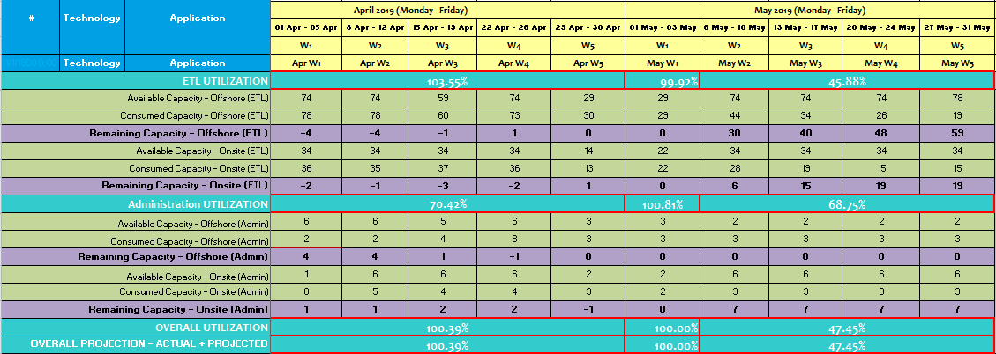
O&T Dashboard: Weekly Project Management Status
ETL O&T Dashboard – Demand Planning Effort

Slide 7
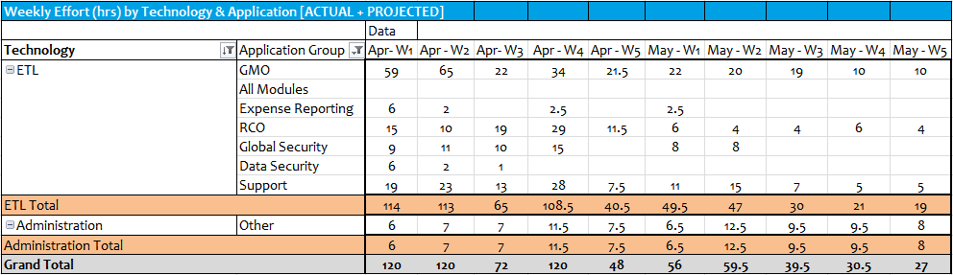
O&T Dashboard: Weekly Project Management Status
ETL O&T Dashboard – Demand Planning Effort By Application

Slide 8
O&T Dashboard: Weekly Project Management Status
ETL ServiceNow Tickets ~ As of 5/3/2019
Module/Function | Application Requests (Defects / Enhancements) |  |  |  |  | Service Requests |  |  |  | Incident | Release | Change Request | Change Task | Total
 | Scoping | On Hold | Work In Progress | Completed | Deployment | Submitted | In Progress | On Hold | Completed
All Modules |  |  |  |  |  |  | 4 |  |  |  |  |  |  | 4
Expense Reporting |  | 1 | 1 |  |  |  |  |  | 2 | 1 |  | 1 | 3 | 9
GMO |  |  | 3 |  |  | 3 | 7 | 1 |  |  |  | 1 |  | 15
RCO | 1 | 1 | 1 | 1 |  | 1 | 5 | 1 | 1 | 6 | 1 | 1 | 2 | 22
Support |  |  |  |  |  | 2 | 2 | 1 | 2 |  |  |  |  | 7
Data Security |  |  |  |  |  |  | 1 |  |  |  |  |  |  | 1
Global Security |  |  | 1 |  |  |  | 2 |  |  |  |  |  |  | 3
Grand Total | 1 | 2 | 6 | 1 | - | 6 | 21 | 3 | 5 | 7 | 1 | 3 | 5 | 61

Slide 9
O&T Dashboard: Weekly Project Management Status
Ticket Category – Monthly Breakdown (ETL)
2019 | Enhancements |  |  | Service Requests |  |  | Incidents |  |  | Defects |  |  | TOTAL
 | Open | Closed | Balance | Open | Closed | Balance | Open | Closed | Balance | Open | Closed | Balance | Open | Closed | Balance
Jan | 2 | 4 | 13 | 14 | 14 | 7 | 6 | 6 | 0 | 0 | 0 | 0 | 22 | 24 | 20
Feb | 4 | 7 | 10 | 21 | 17 | 11 | 21 | 20 | 1 | 0 | 0 | 0 | 46 | 44 | 22
Mar | 4 | 6 | 8 | 15 | 11 | 15 | 23 | 24 | 0 | 0 | 0 | 0 | 42 | 41 | 23
Apr | 4 | 1 | 11 | 25 | 21 | 19 | 26 | 26 | 0 | 0 | 0 | 0 | 55 | 48 | 30
May
Jun
Jul
Aug
Sep
Oct
Nov
Dec
TOTAL | 14 | 18 | 11 | 75 | 63 | 19 | 76 | 76 | 0 | 0 | 0 | 0 | 165 | 157 | 30

Slide 10
O&T Dashboard: Weekly Project Management Status
Overall Resource Utilization ~ Week Ending 5/3/2019 - ETL
*All Modules refers to User Provisioning requests, ETL monitoring tasks, system testing and any O&T related requests with other teams.

Slide 11
O&T Dashboard: Weekly Project Management Status
Resource Breakdown Hours (Tableau, ETL & .NET) – Period Ending 5/3/2019
Tableau
Resources | Roles | Location | Planned Hours | Actual Hours |  |  | Variance Hours Planned vs. Actual
 |  |  |  | O&T Dashboard | Other | Total
Palguna Asapanna | Tableau Sr. Developer | Onsite | 40.00 | 24.00 | 8.00 | 32.00 | 8.00
Karthick Arasilamani | Tableau Sr. Developer | Offshore | 40.00 | 34.00 | 6.00 | 40.00 | 0.00
Grand Total |  |  | 80.00 | 58.00 | 14.00 | 72.00 | 8.00
ETL
Resources | Roles | Location | Planned Hours | Actual Hours |  |  | Variance Hours Planned vs. Actual
 |  |  |  | O&T Dashboard | Other | Total
Paulnaveen Selvakumar | ETL Development & Support | Onsite | 40.00 | 35.00 | 5.00 | 40.00 | 0.00
Rajasekhar Boppasamudram | ETL Development | Offshore | 40.00 | 29.00 | 3.00 | 32.00 | 8.00
Aswin Madhavan | ETL Support | Offshore | 40.00 | 29.50 | 2.50 | 32.00 | 8.00
Grand Total |  |  | 120.00 | 93.50 | 10.50 | 104.00 | 16.00
.NET
Resources | Roles | Location | Planned Hours | Actual Hours |  |  | Variance Hours Planned vs. Actual
 |  |  |  | O&T Dashboard | Other | Total
NithyaKumar Rangan | .NET Support | Onsite | 3.00 | 0.00 | 0.00 | 0.00 | 3.00
Grand Total |  |  | 3.00 | 0.00 | 0.00 | 0.00 | 3.00

Slide 12
O&T Dashboard: Weekly Project Management Status
Thank You

